Slide 1

OOP Project
Hospital System
Name: omar ashraf Mahmoud
Id: 202400725

Slide 2
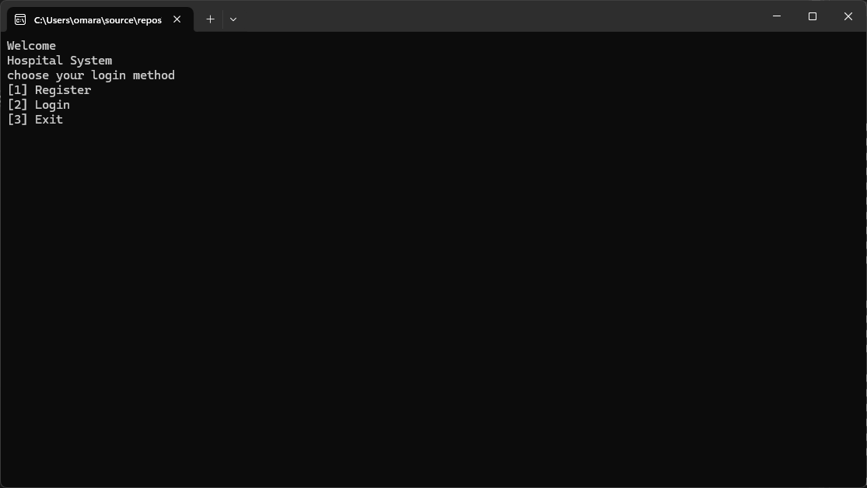
When you first launch the app you will be greeted with this window

Slide 3
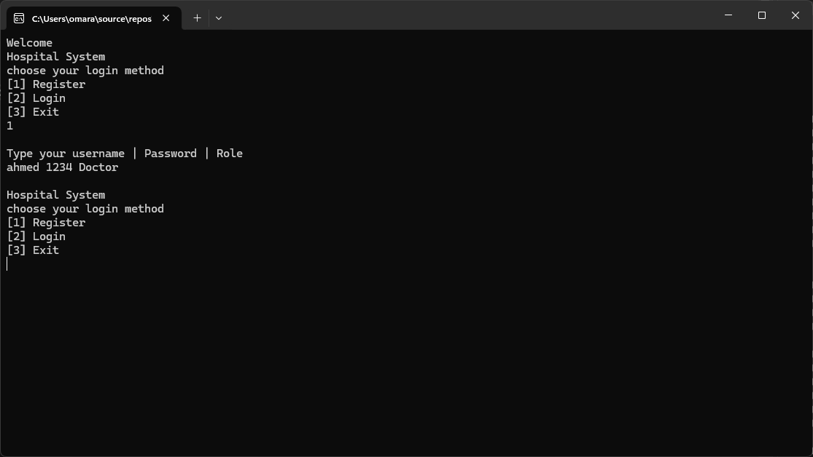
Since you are a first time you can register for yourself by writing your info and role

Slide 4
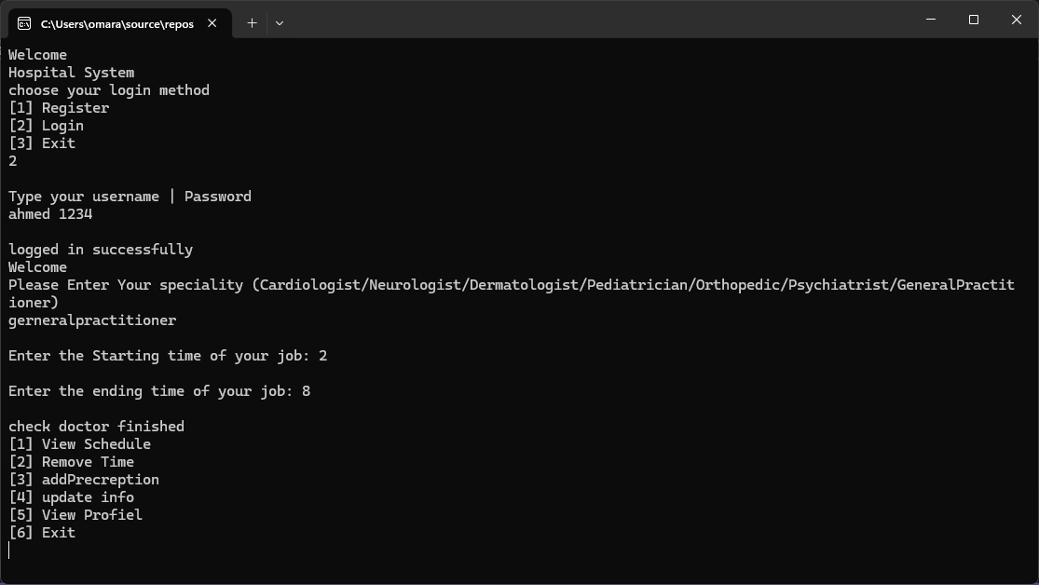
When you type your name and password at login, it will automatically open up the correct window for you.
As this your opening up the doctor window you will have to choose your specialty and your starting time of job and ending time.
And when you open the window it will show you those options.

Slide 5
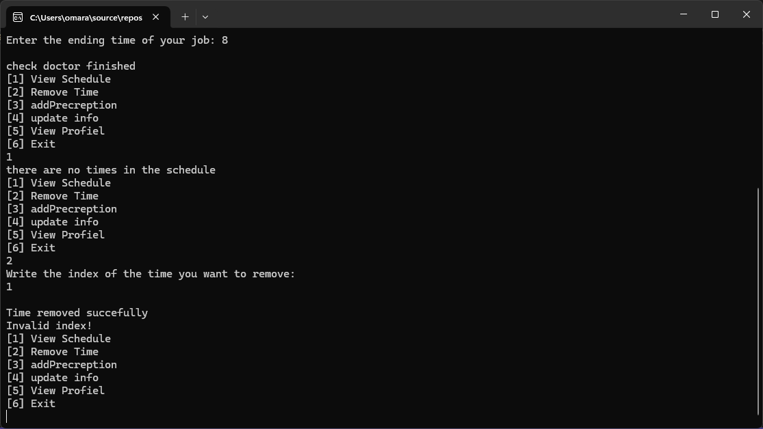
First Option which is viewing your schedule and people assigned to you, and you can remove times if you needed, and will return invalid index if no one is in that time

Slide 6
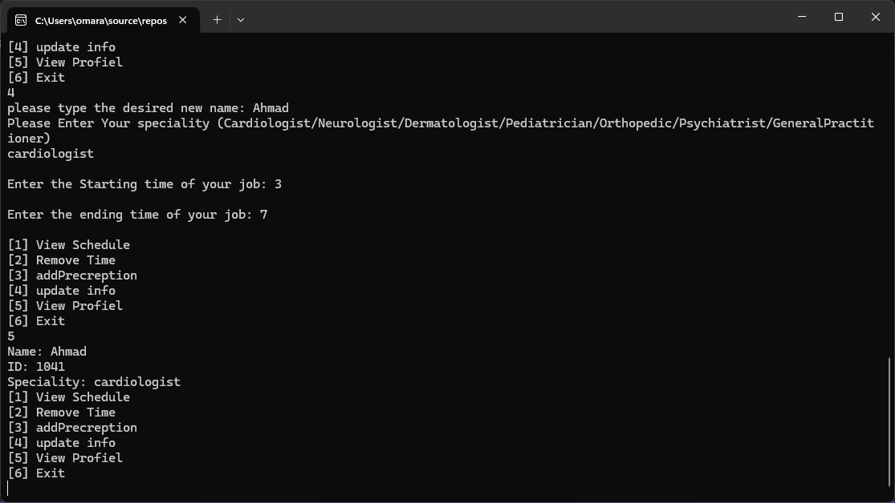
You also have the option to edit your profile as well, by typing the new name, specialty, and new times, and view them in other options

Slide 7
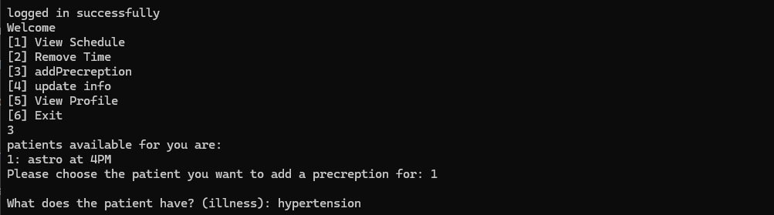
When choose to add prescription it will display all the patients that requested to see you and then you can type out what illness they have, and save it in their file.

Slide 8
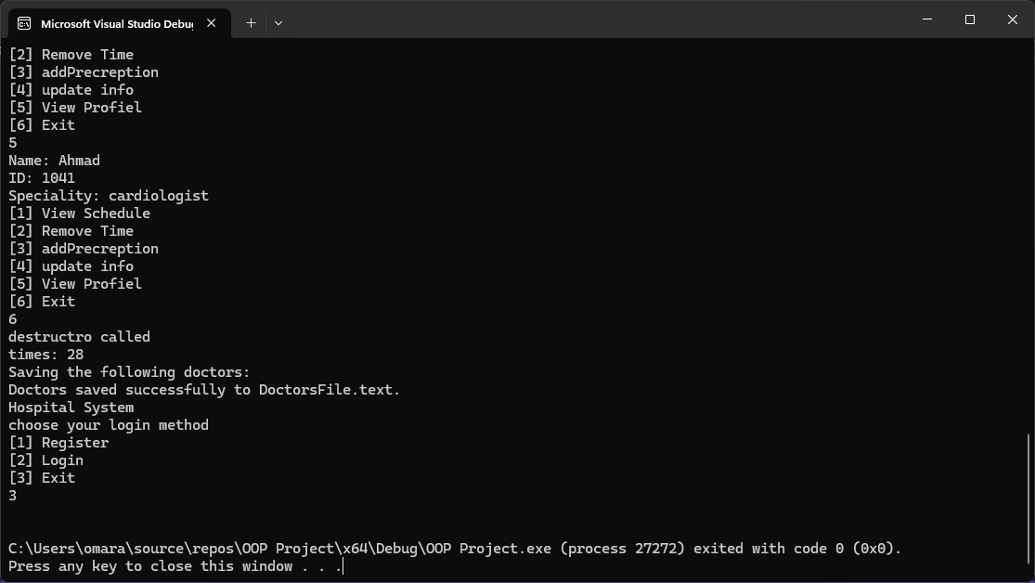
After Finishing you can exit and it will save your info in a file successfully to log in with something else.

Slide 9
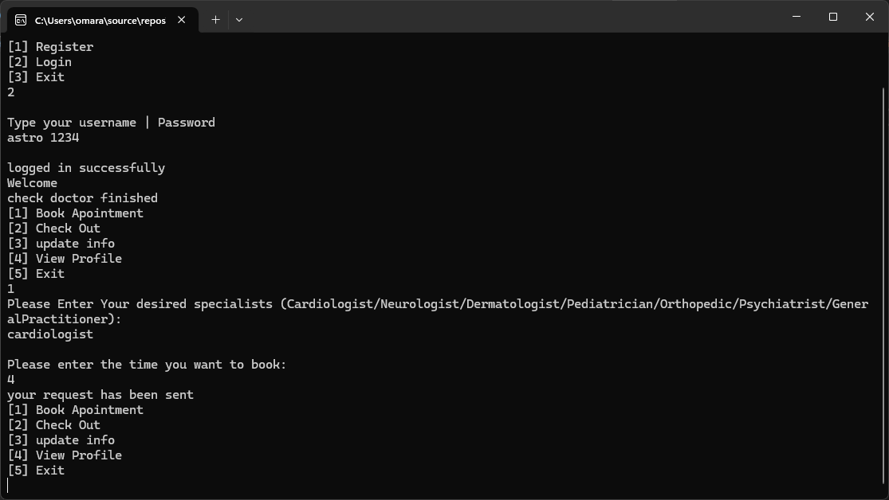
Patient Role:
in patient role you will be greeted with the same update and view info as in the doctor role, but now you can book appointment and check-out.

Slide 10
Now when you choose to book an appointment, you will choose which doctor specialist you want to meet and you type it, then type the time you want and your request will be sent.

Slide 11
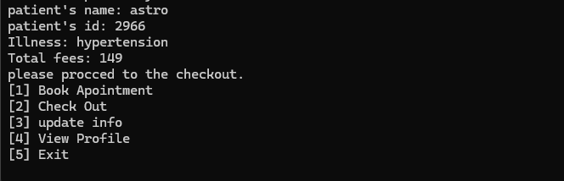
You can also cash out after checking with the doctor and it will display your full price.

Slide 12
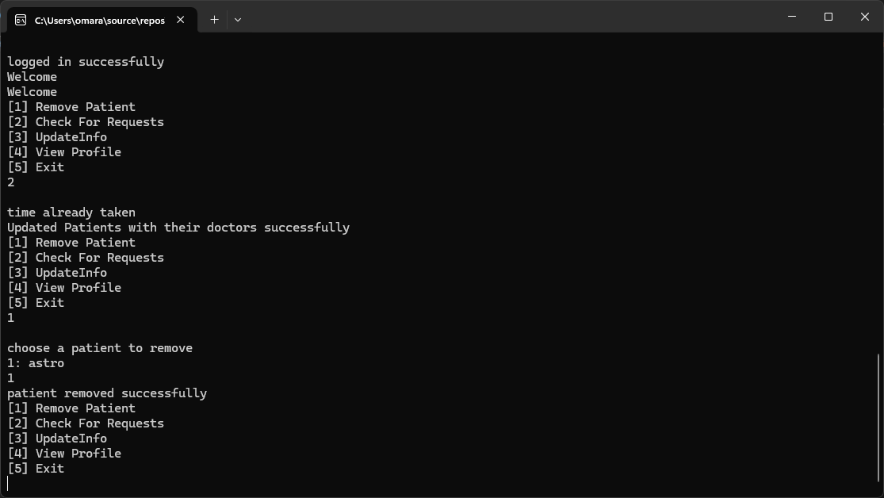
Admin role:
Here you will be greeted with the same updateinfo and view info as the doctor and patient, but along side remove patient and check for requests

Slide 13
In check for requests it checks automatically if there are any requests from the patients and then assigns them with the correct doctor

Slide 14
And if you choose to remove a patient it will display all the patients and delete the one you choose

Slide 15
Thank You

